Slide 1
WP1
Path Enumeration

Slide 2
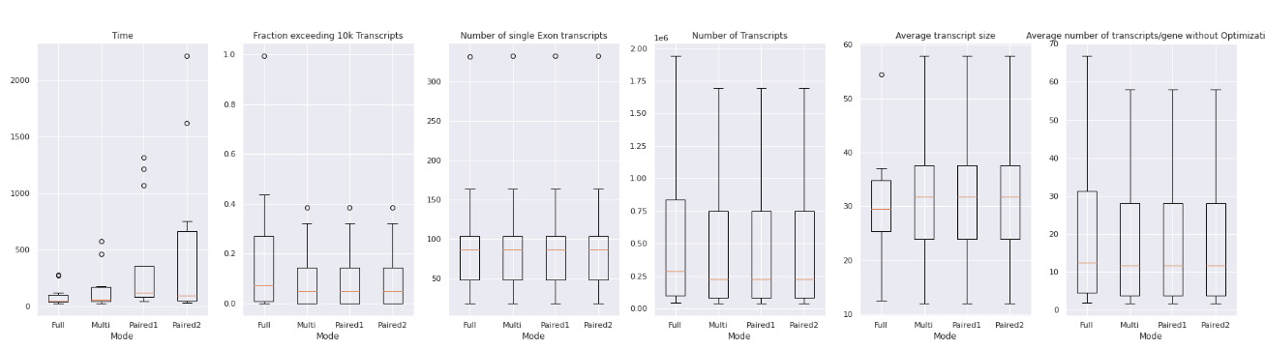

Slide 3
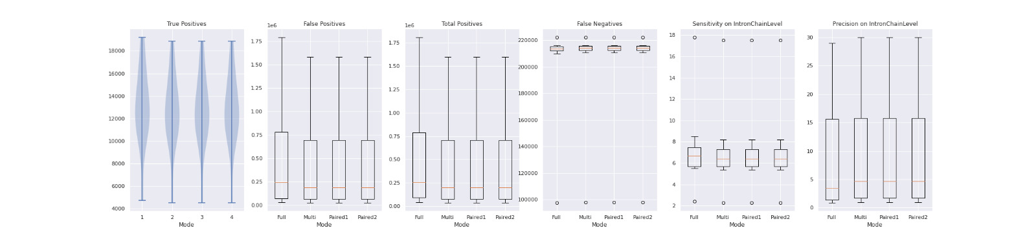

Slide 4
Datasets:
Human_simulated
Human_leukemia
Human Diverse:
SRR307903
SRR307911
SRR315323
SRR315334
SRR387661
SRR534291
SRR534307
SRR534319
SRR545695

Slide 5
WP2
Optimization with Gurobi

Slide 6
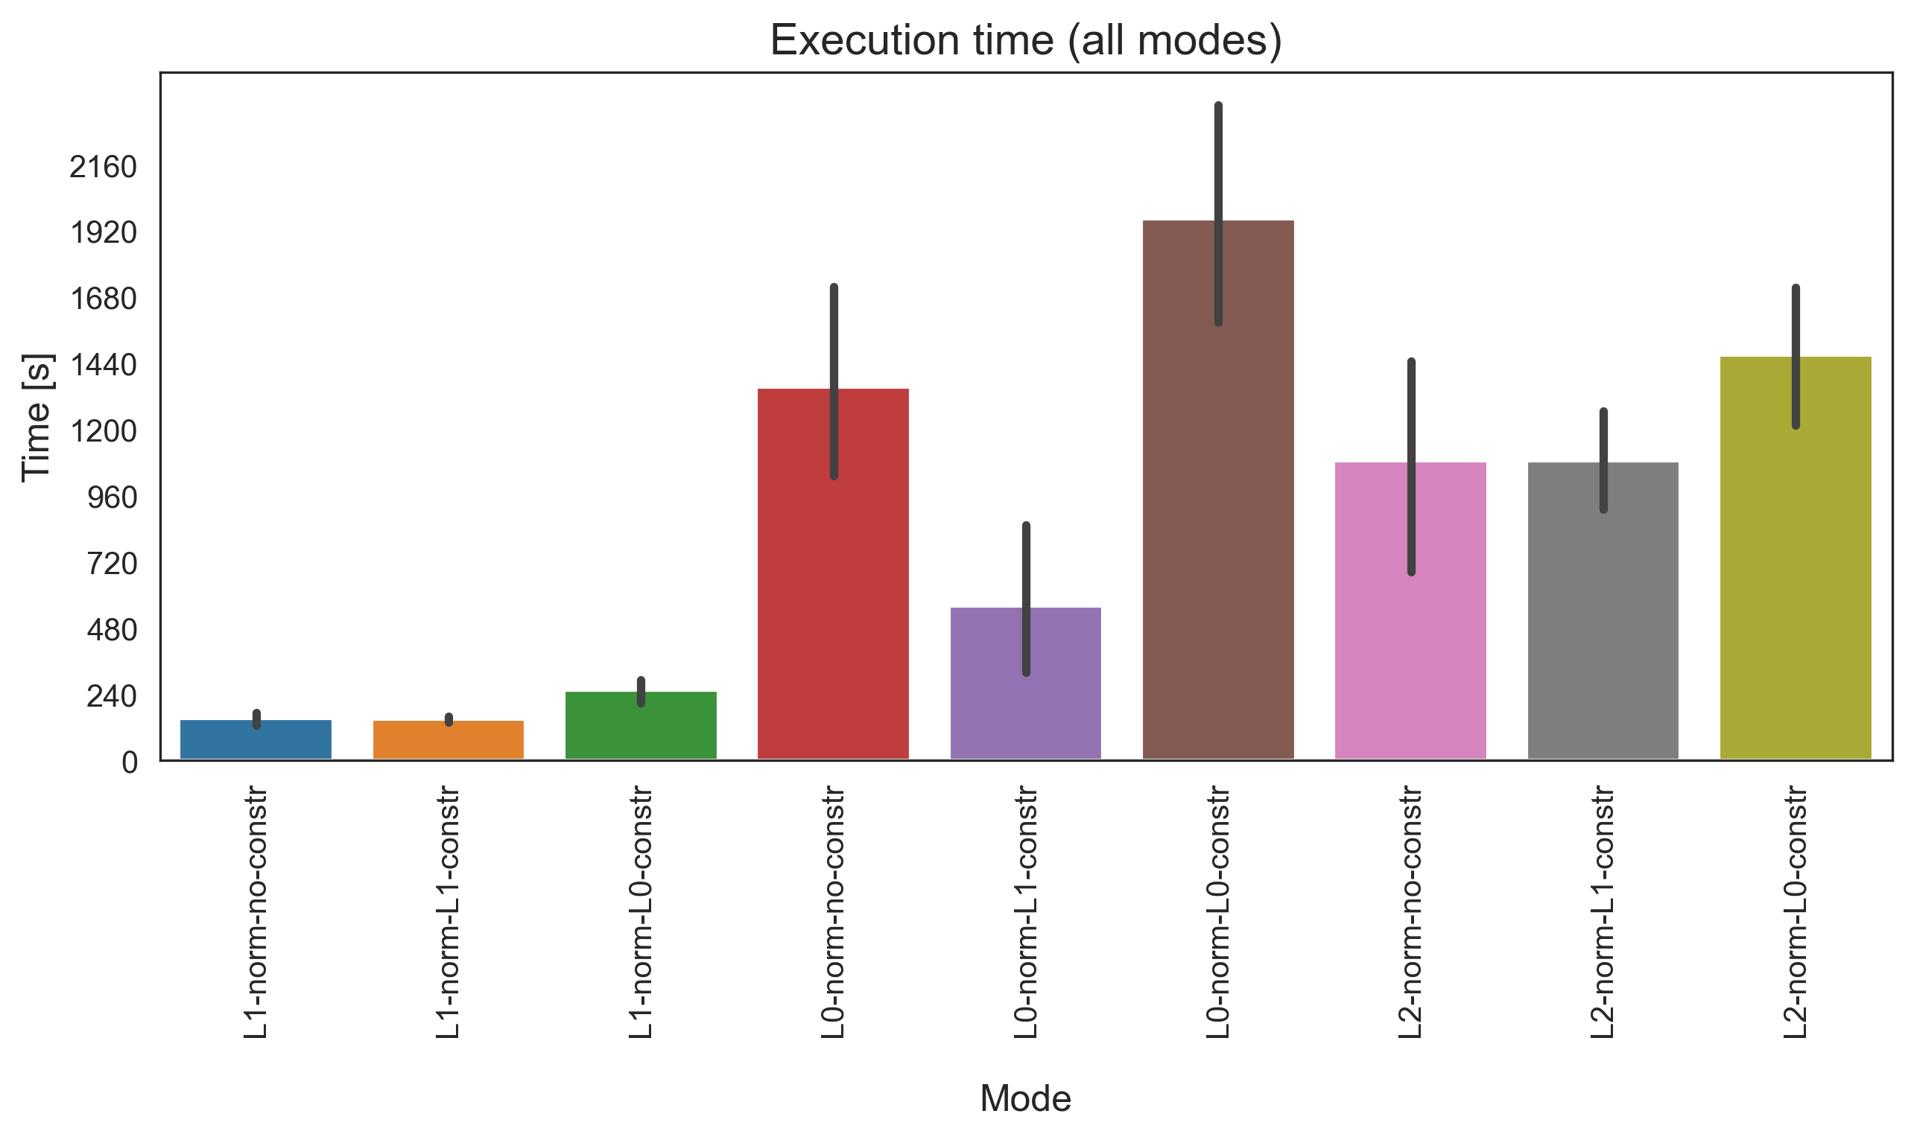
Execution time for one graph file
Full Path Enumeration
Datasets
Human geuvadis simulated
Human leukemia real
Human diverse
SRR307903 (Fibroblasts)
SRR307911 (Embryonic stem cells)
L1 norm
L0 norm
L2 norm

Slide 7
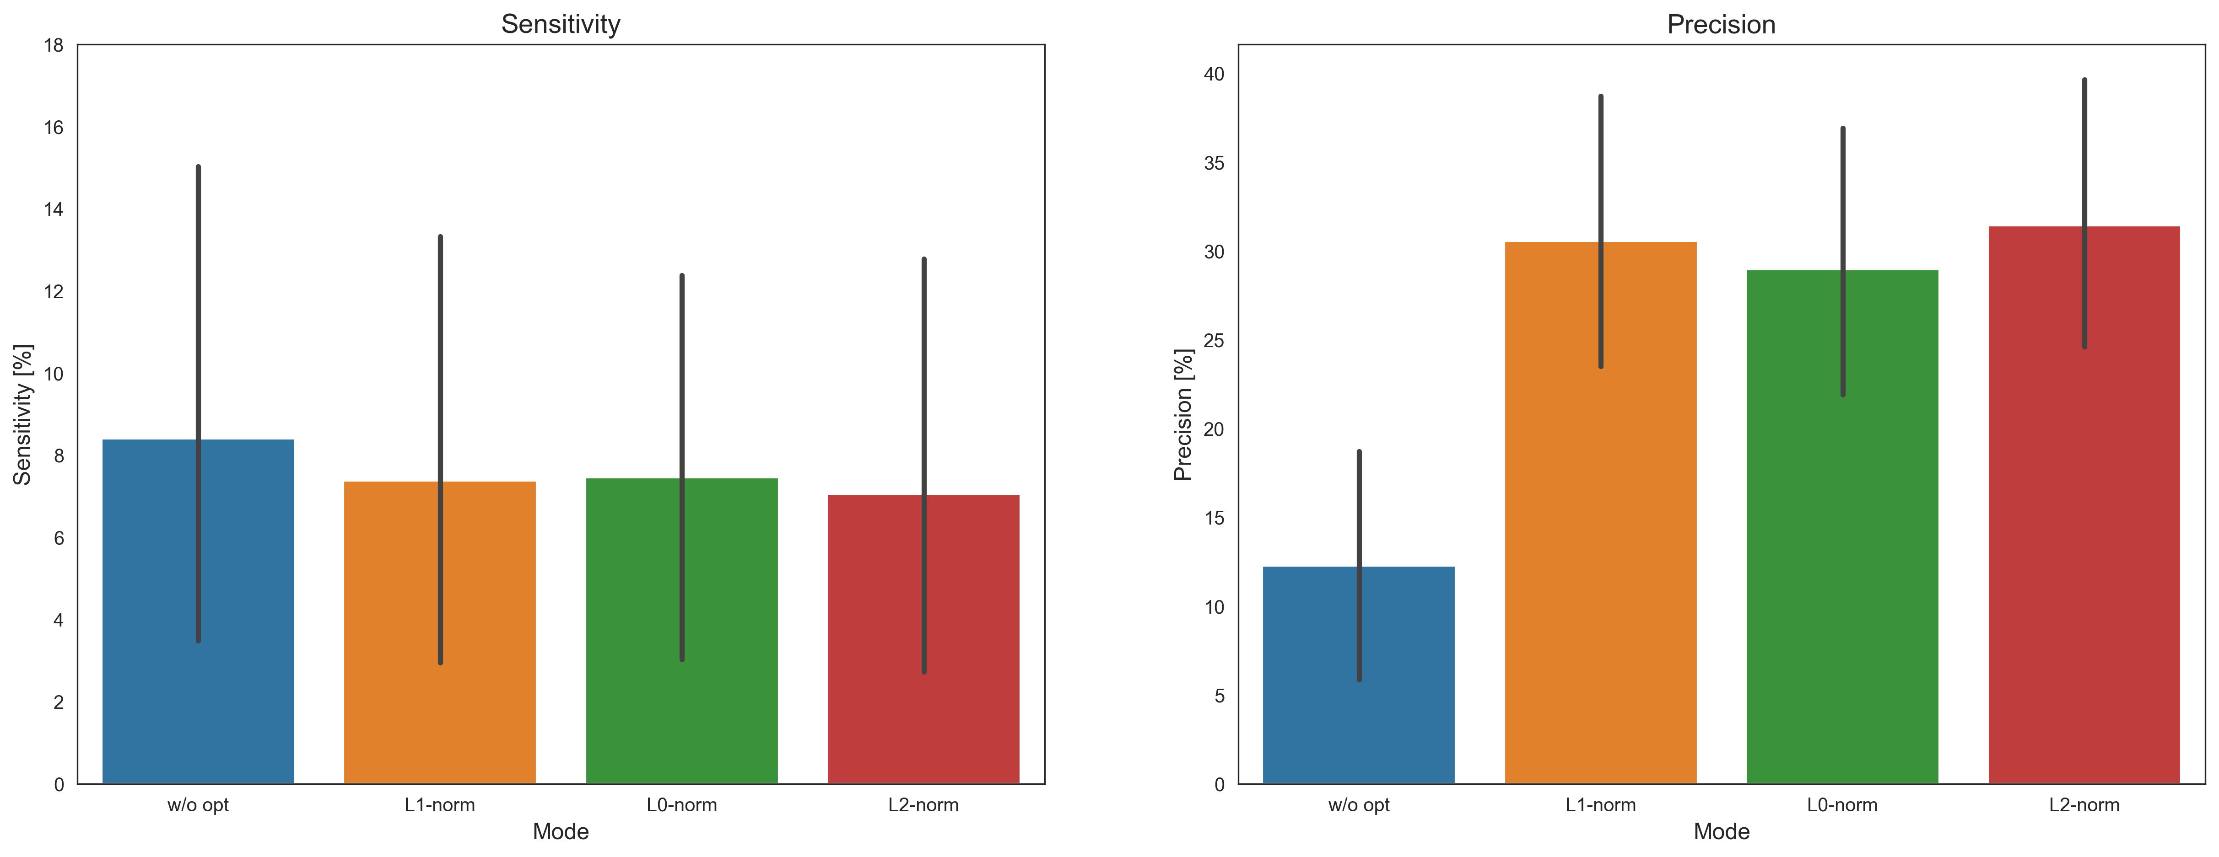
Sensitivity and Precision
Without sparsity constraints

Slide 8
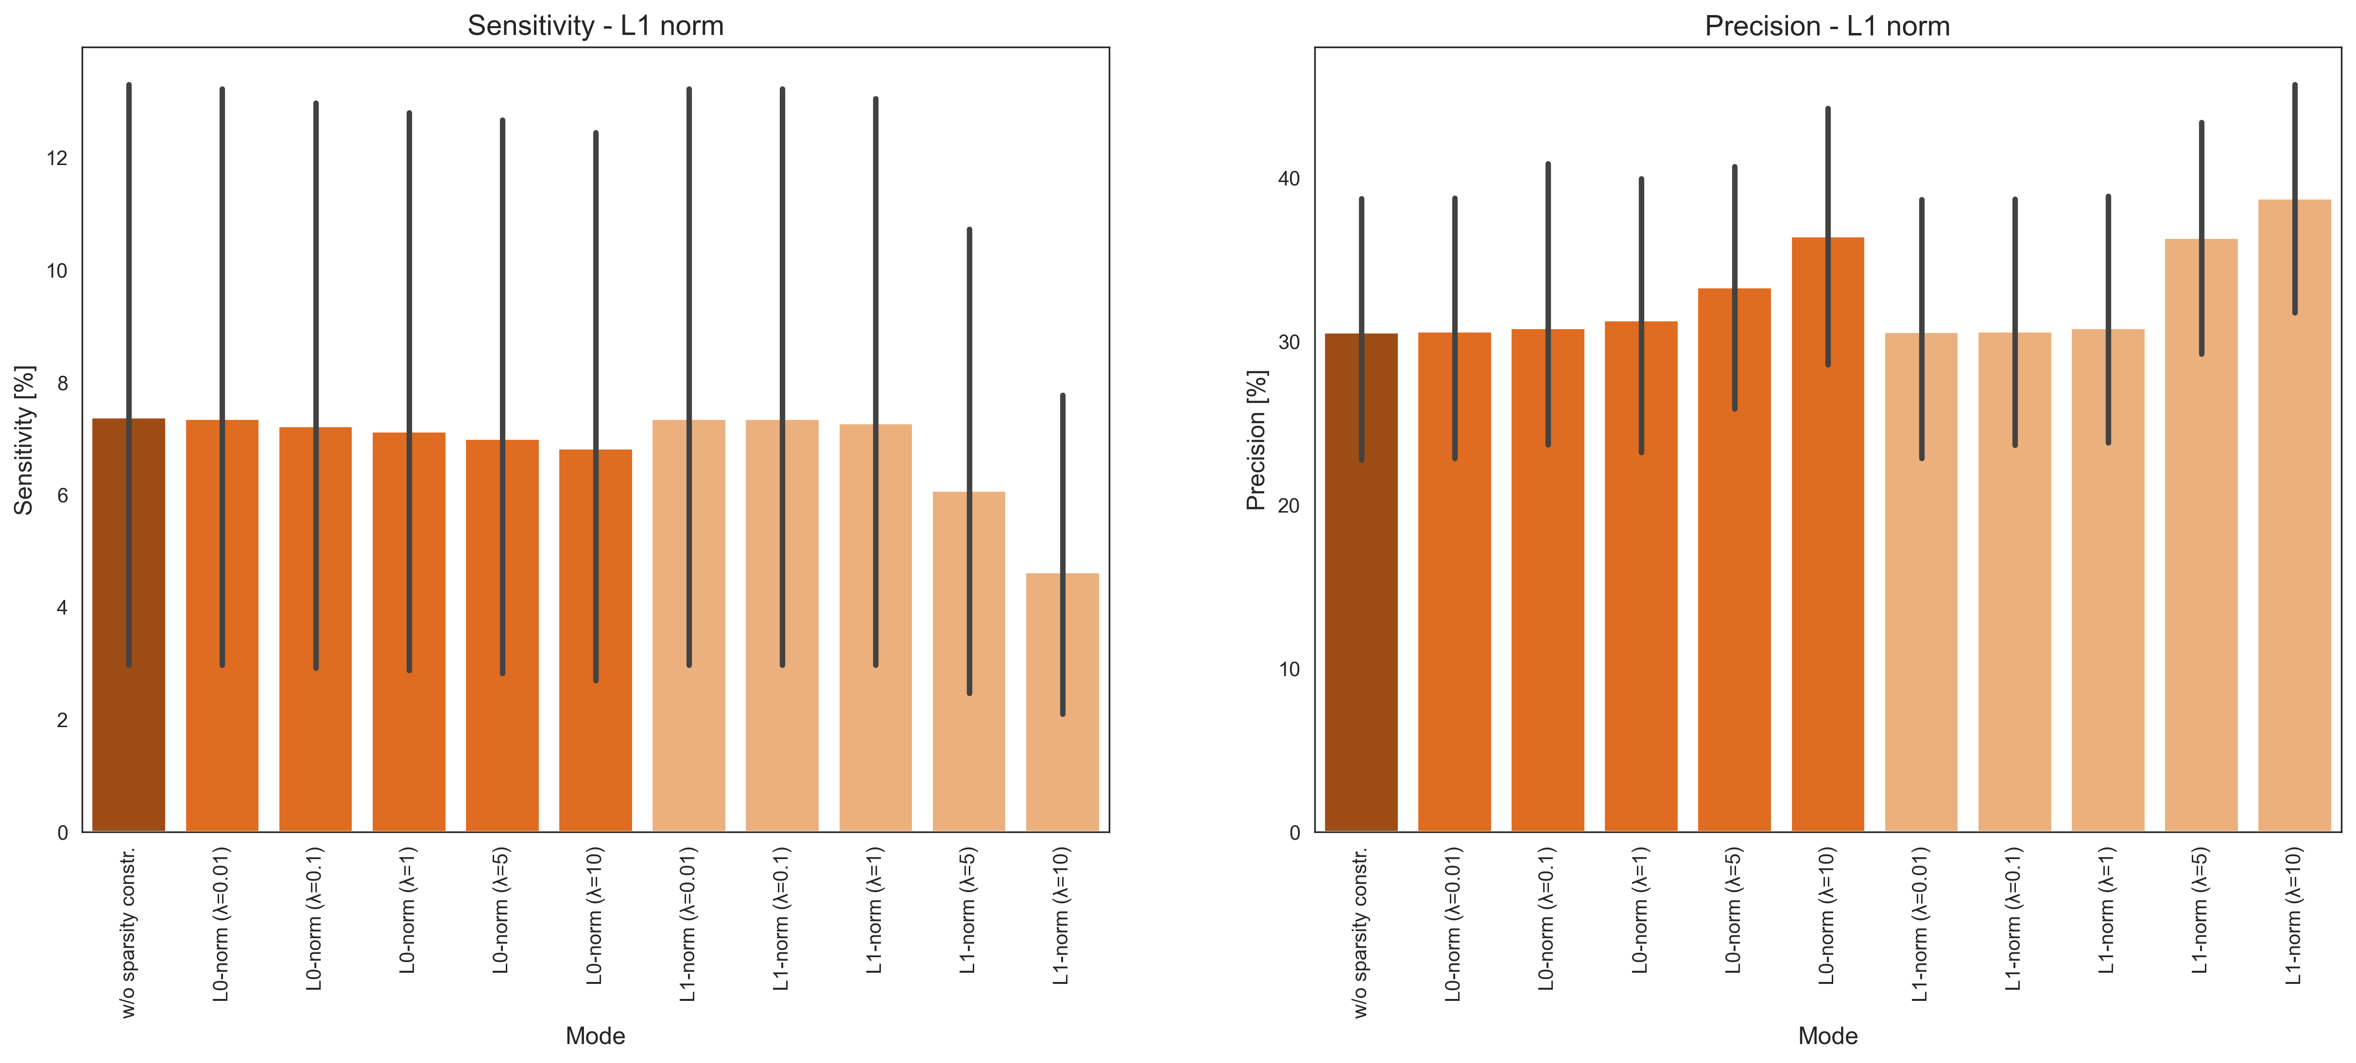
Sensitivity and Precision
With sparsity constraints

Slide 9
WP3
Flow-based Optimization

Slide 10
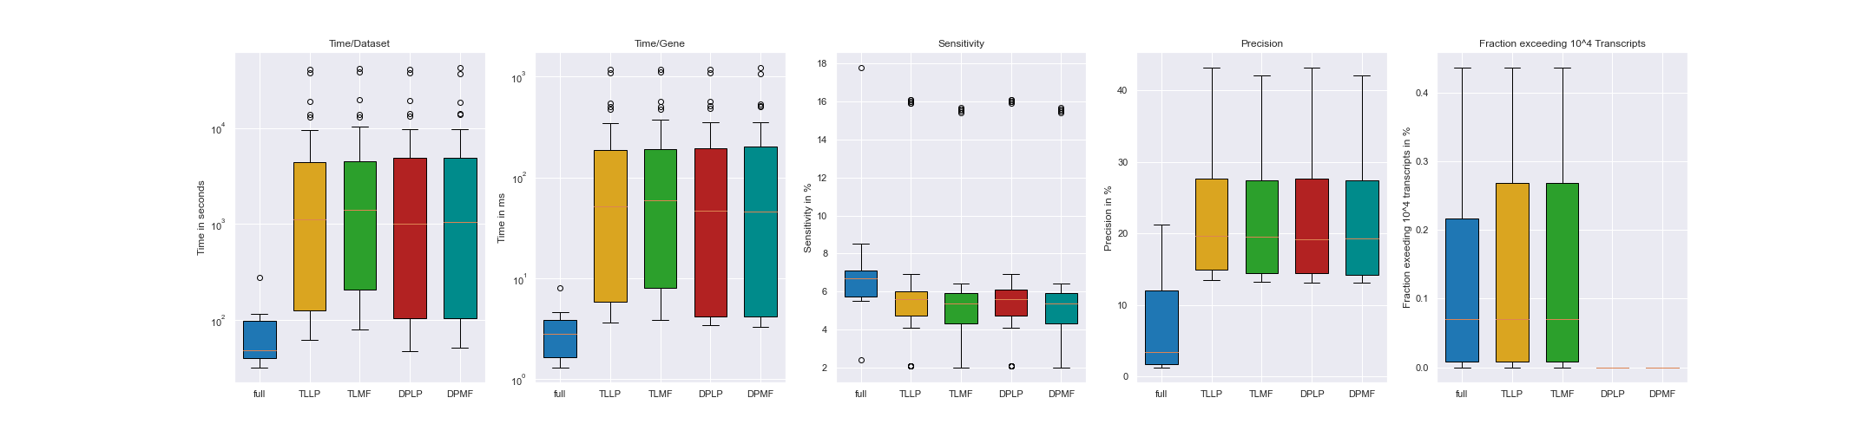
Time Analysis for flow-based Optimization
11 datasets:
Human_simulated
Human_leukemia
Human Diverse
SRR307903
SRR307911
SRR315323
SRR315334
SRR387661
SRR534291
SRR534307
SRR534319
SRR545695
6 cost-functions per mode
3 linear
3 quadratic

Slide 11
Precision and Sensitivity for flow-based Optimization

Slide 12
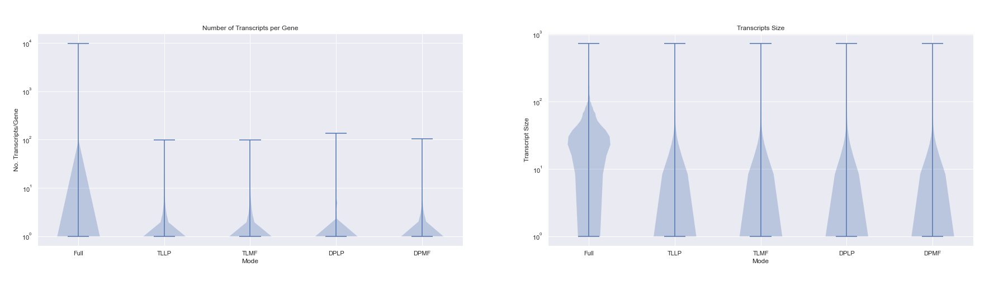
Number of Transcripts and Transcript Size for flow-based Optimization

Slide 13
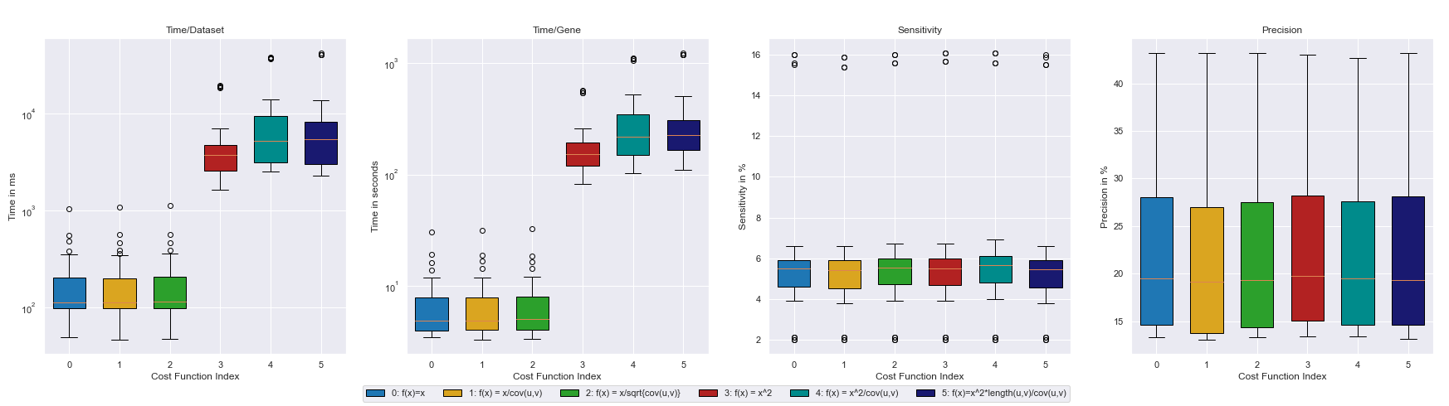
Cost-function dependent results for flow-based Optimization

Slide 14
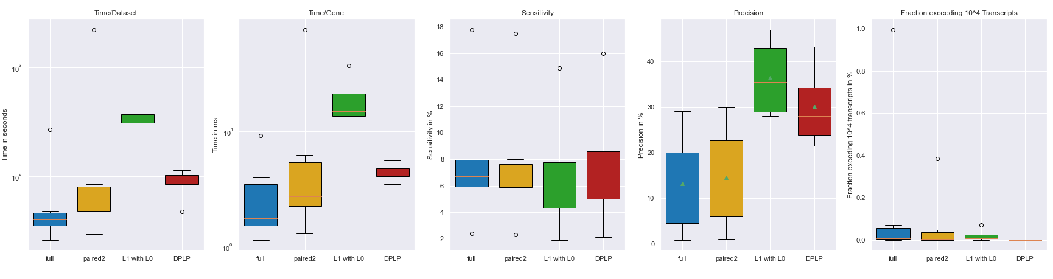
Overall results

Slide 15
Vielen Dank.

Slide 16
Anhang

Slide 17
WP2 - Anhang

Slide 18
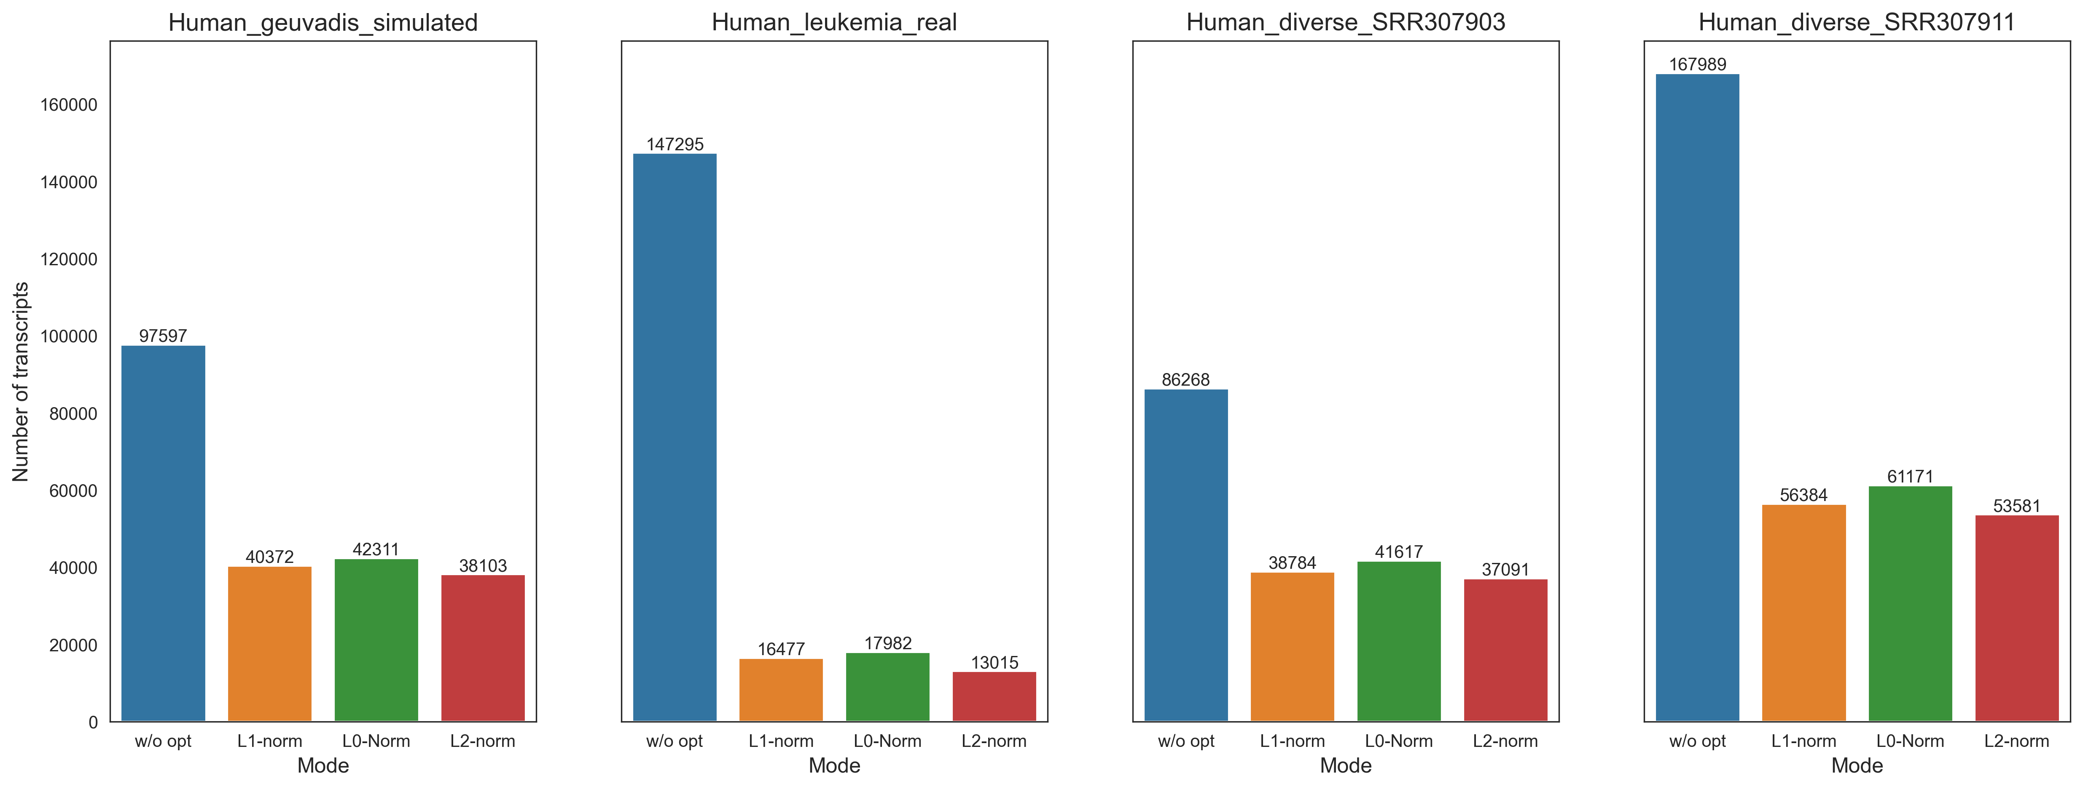
Total number of transcripts
Without sparsity constraints

Slide 19
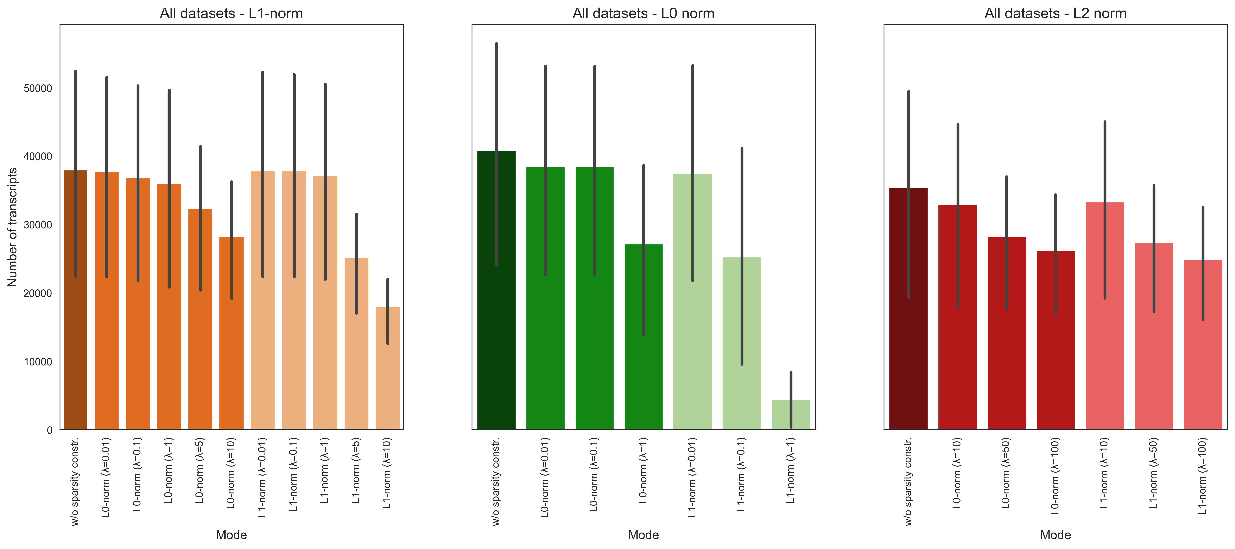
Total number of transcripts
With sparsity constraints

Slide 20
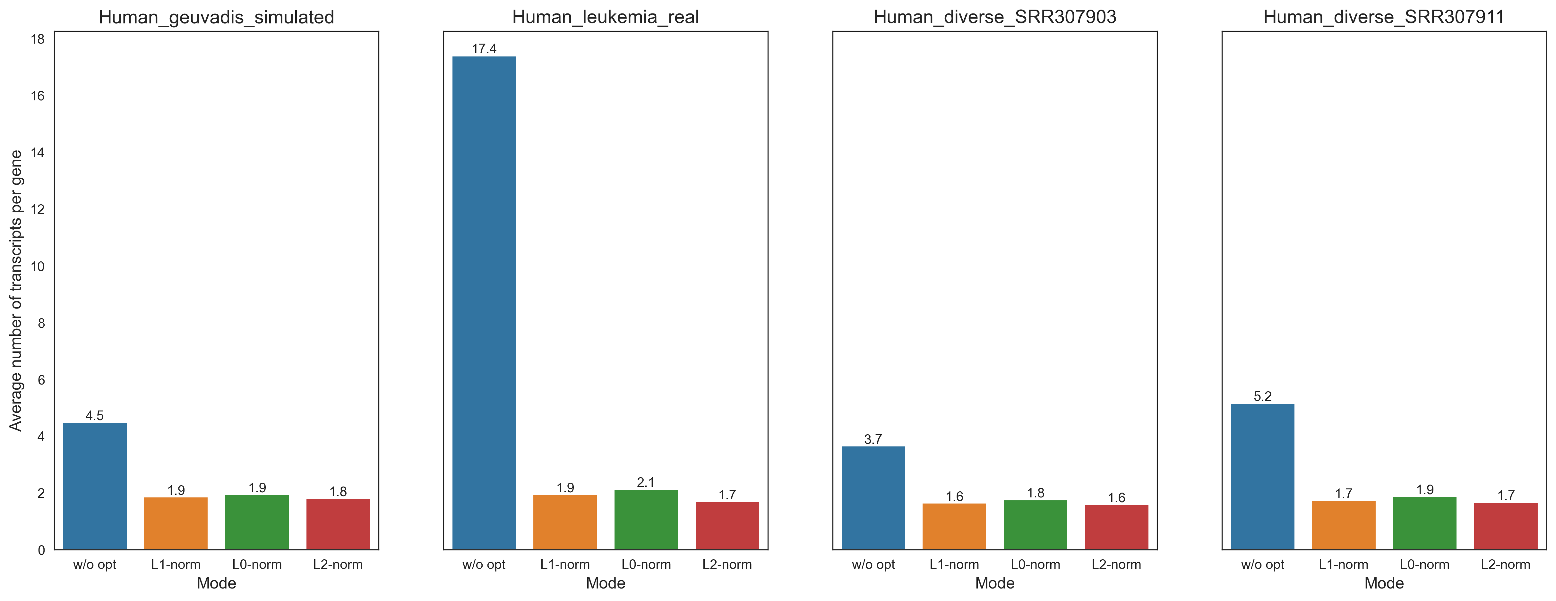
Number of transcripts per gene
Without sparsity constraints

Slide 21
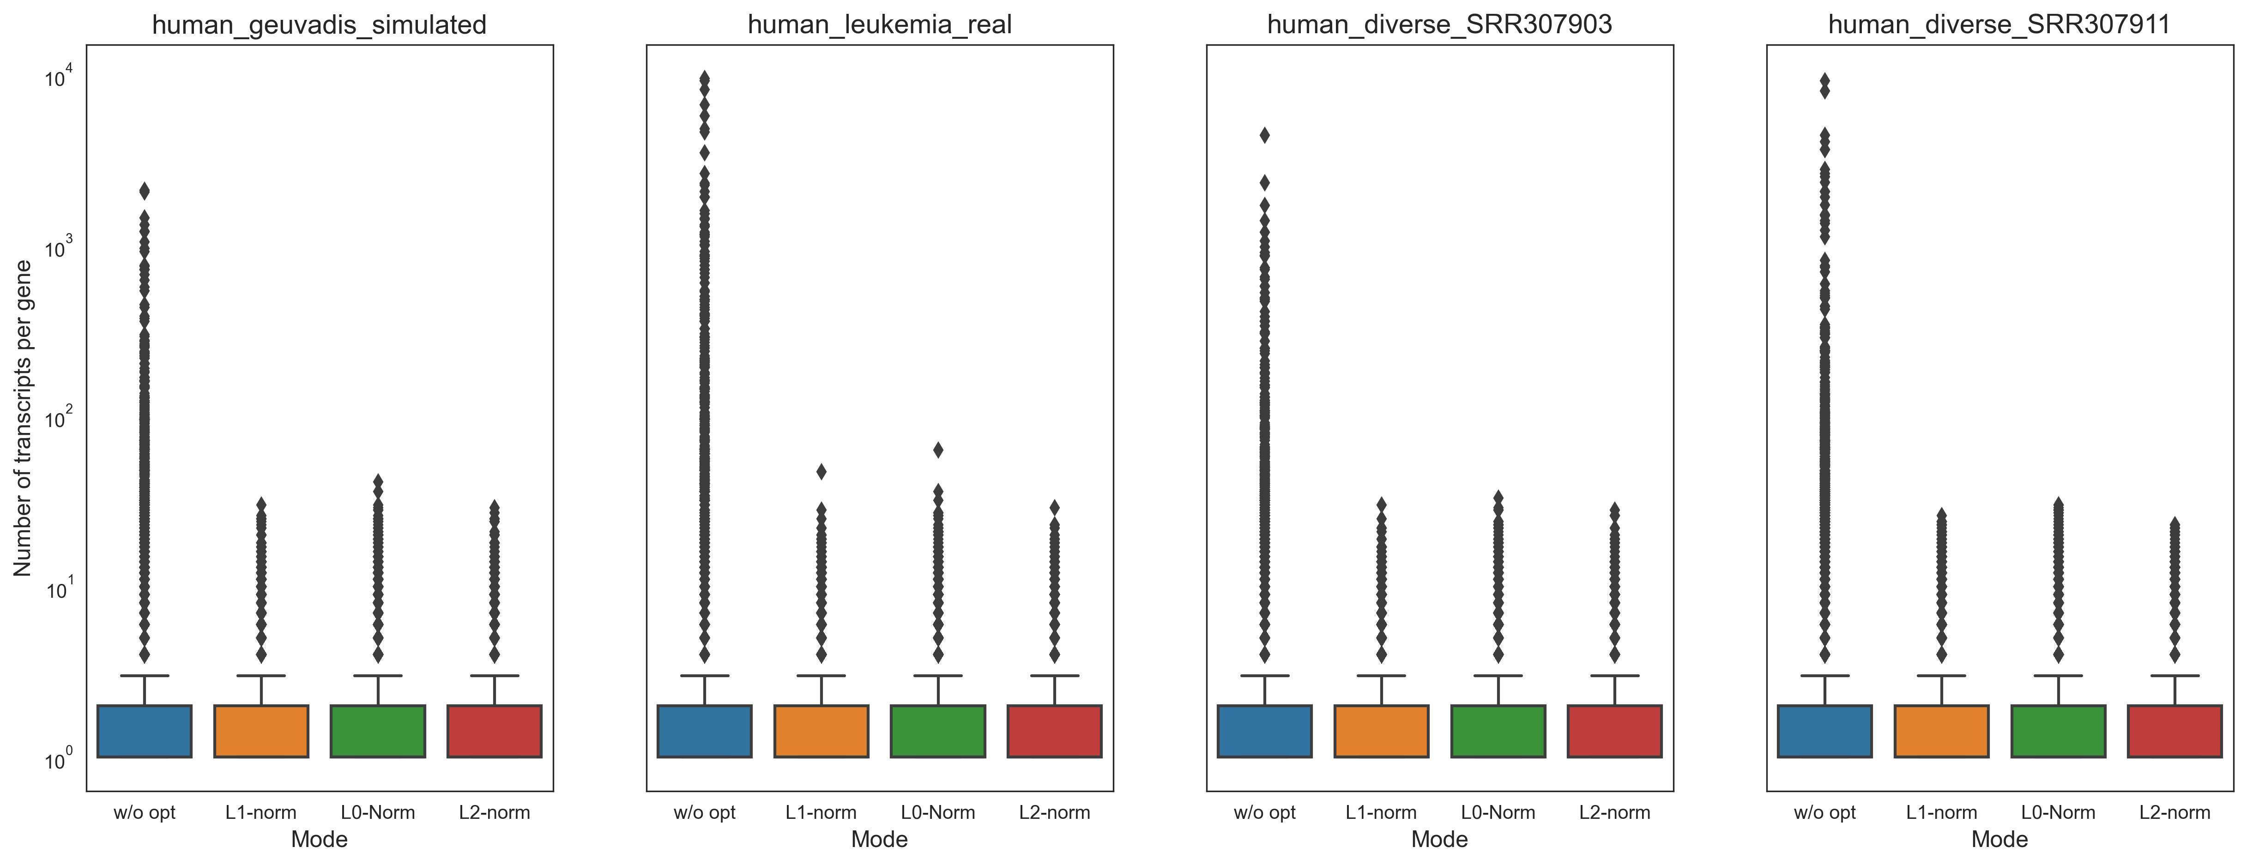
Number of transcripts per gene
Without sparsity constraints

Slide 22
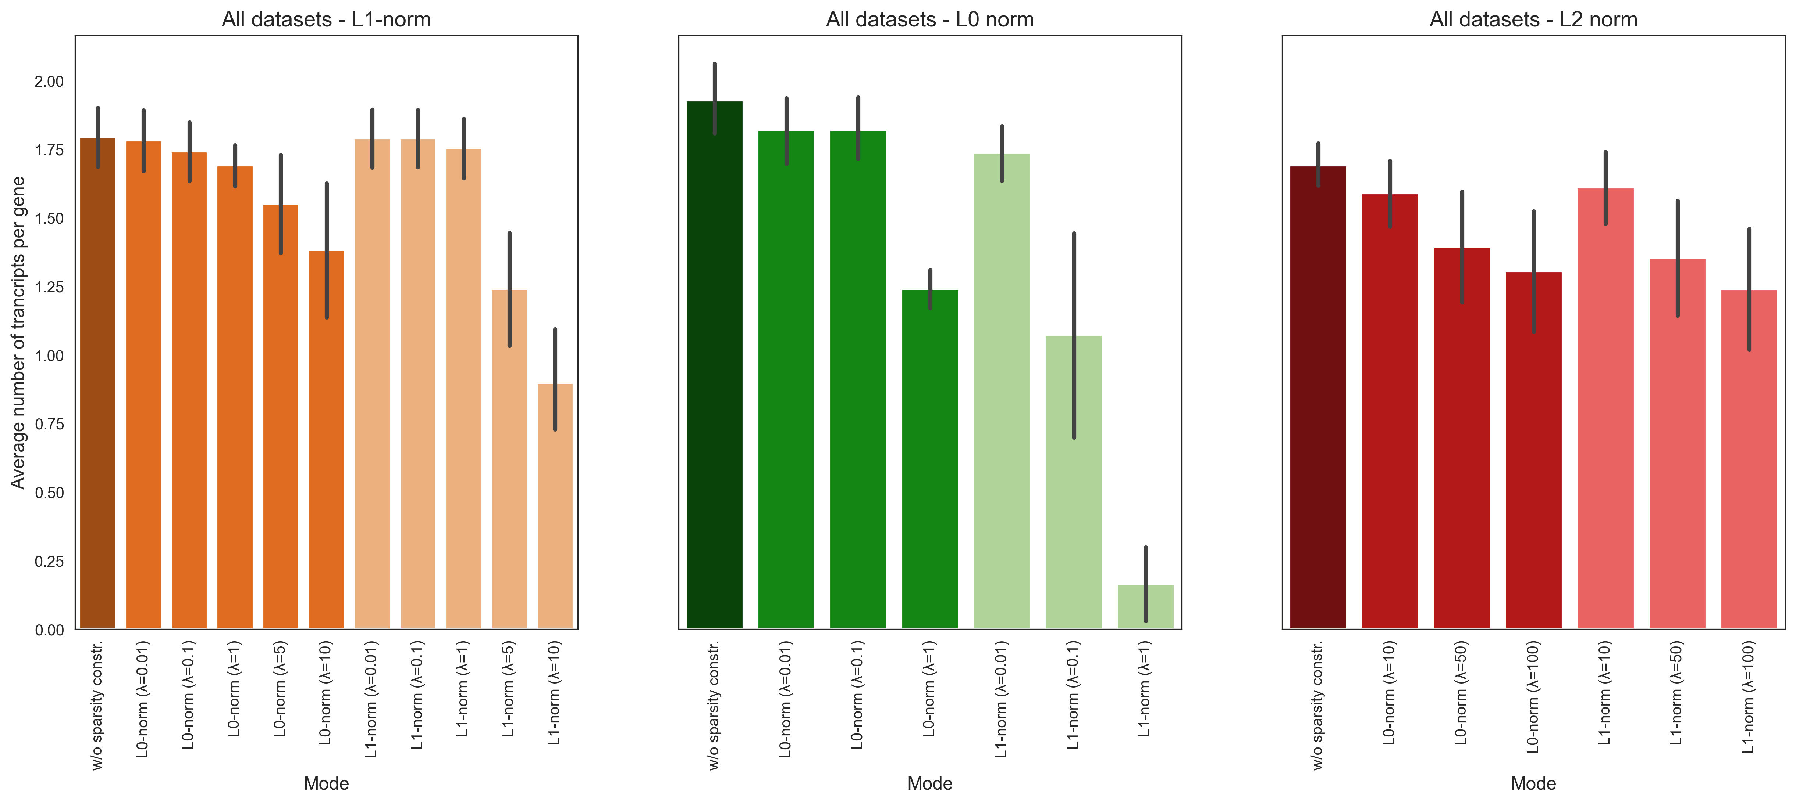
Number of transcripts per gene
With sparsity constraints

Slide 23
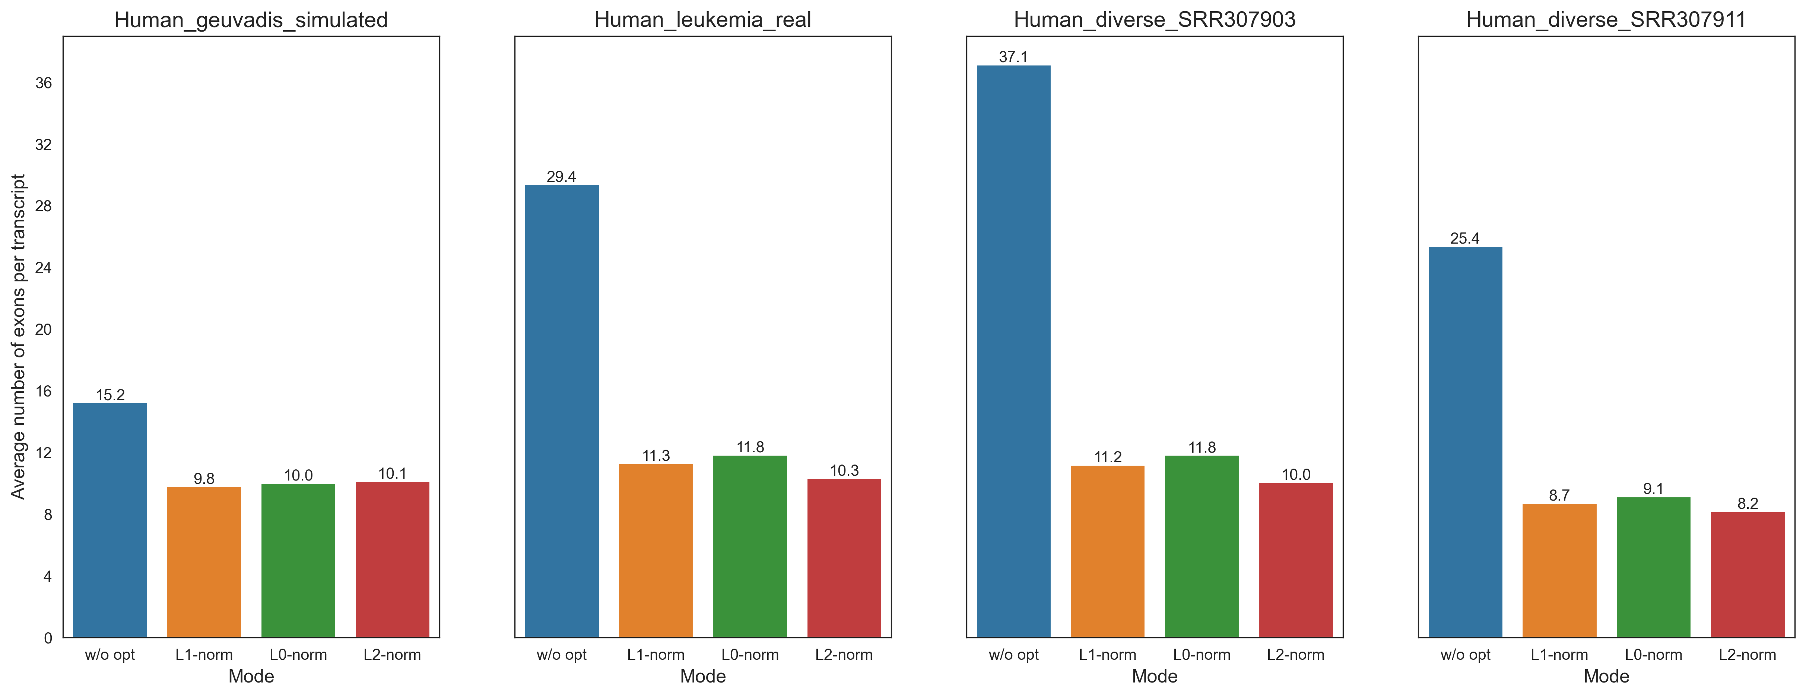
Number of exons per transcript
Without sparsity constraints

Slide 24
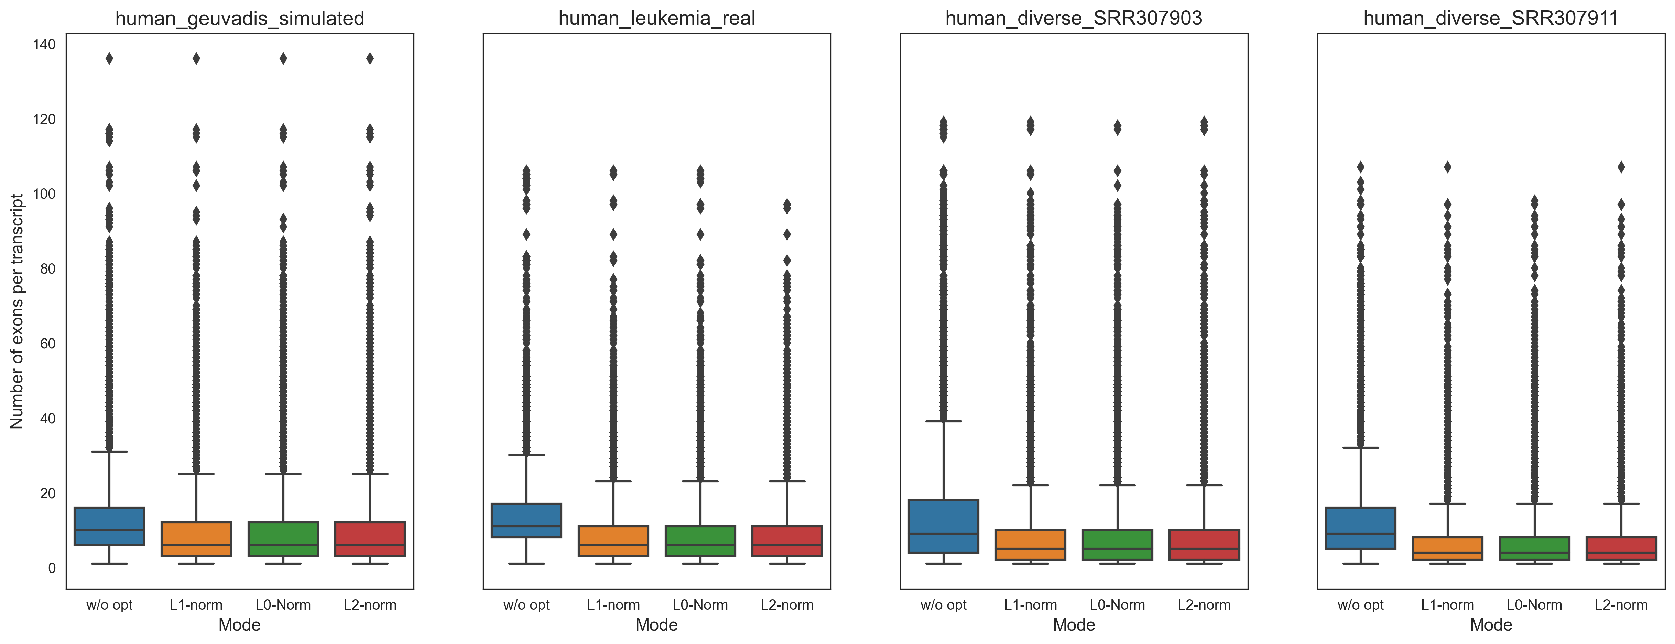
Number of exons per transcript
Without sparsity constraints

Slide 25
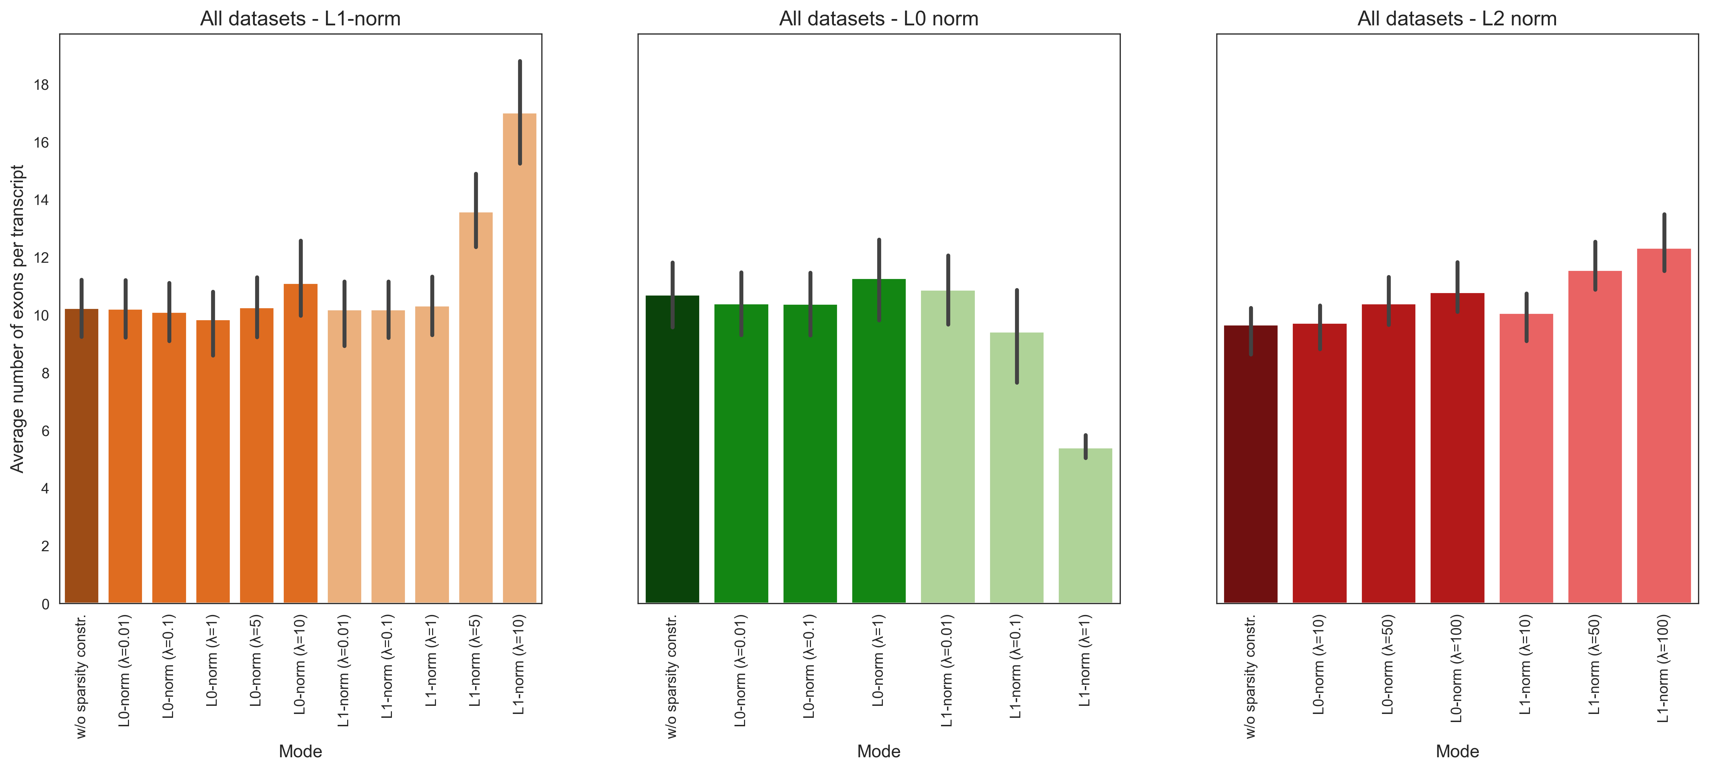
Number of exons per transcript
With sparsity constraints

Slide 26
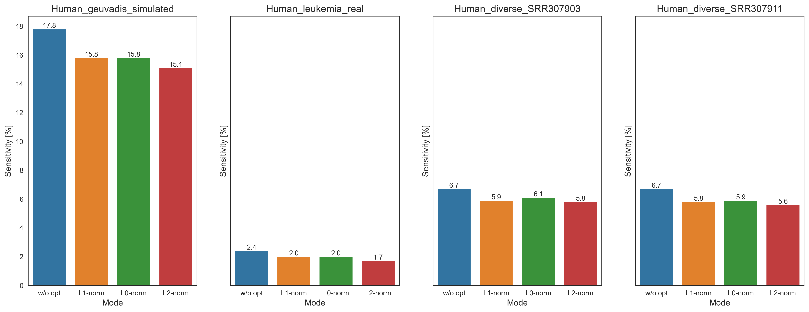

Sensitivity
Without sparsity constraints
$$Sensitivity=\frac{TP}{TP+FN}$$

Slide 27
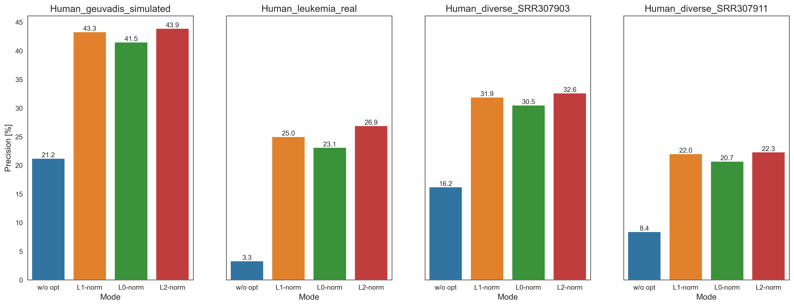
Precision
Without sparsity constraints
$$Precision=\frac{TP}{P}$$

Slide 28
Sensitivity and Precision
L1 norm
With sparsity constraints

Slide 29
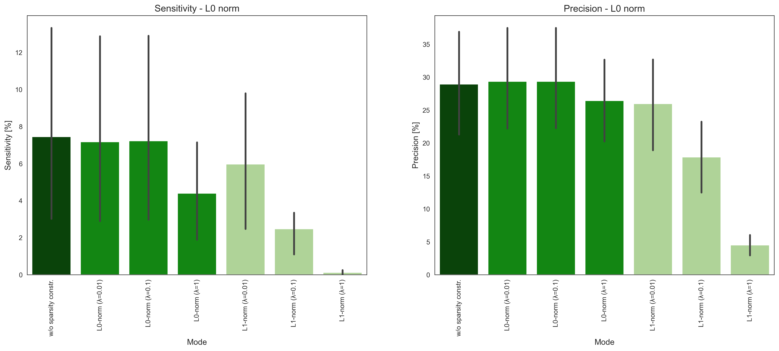
Sensitivity and Precision
L0 norm
With sparsity constraints

Slide 30
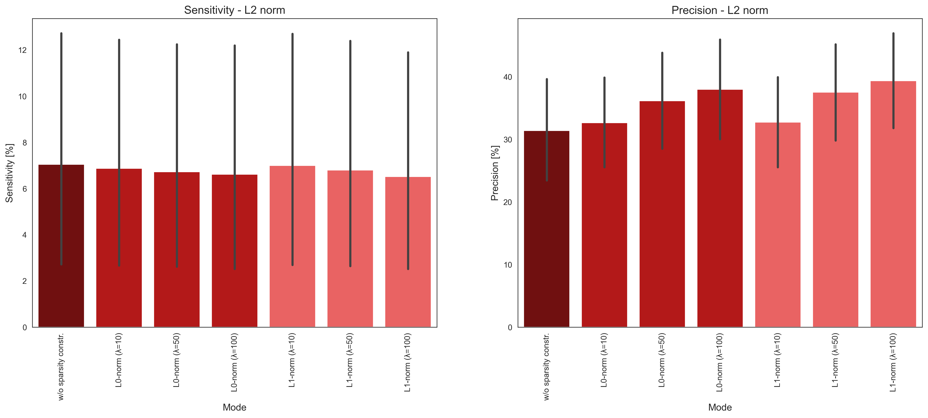
Sensitivity and Precision
L2 norm
With sparsity constraints

Slide 31
Anhang WP3

Slide 32
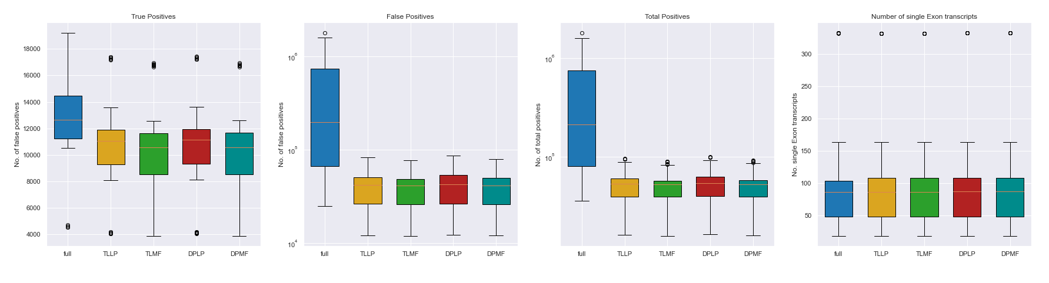
Further Analysis for flow-based Optimization

Slide 33
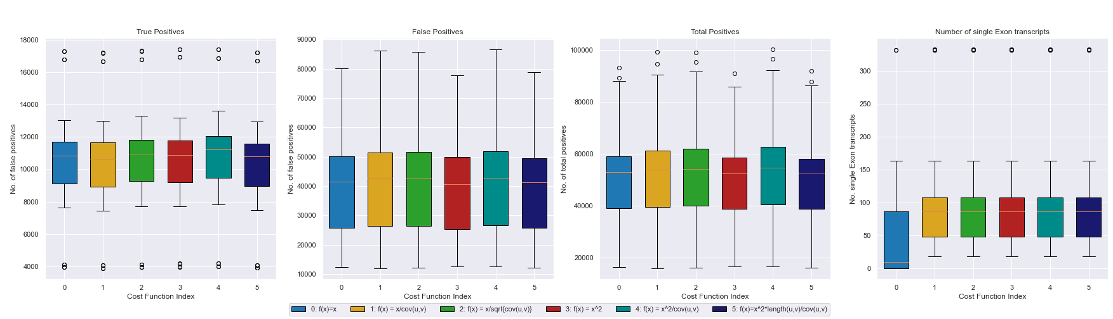
Further Analysis for flow-based Optimization

Slide 34
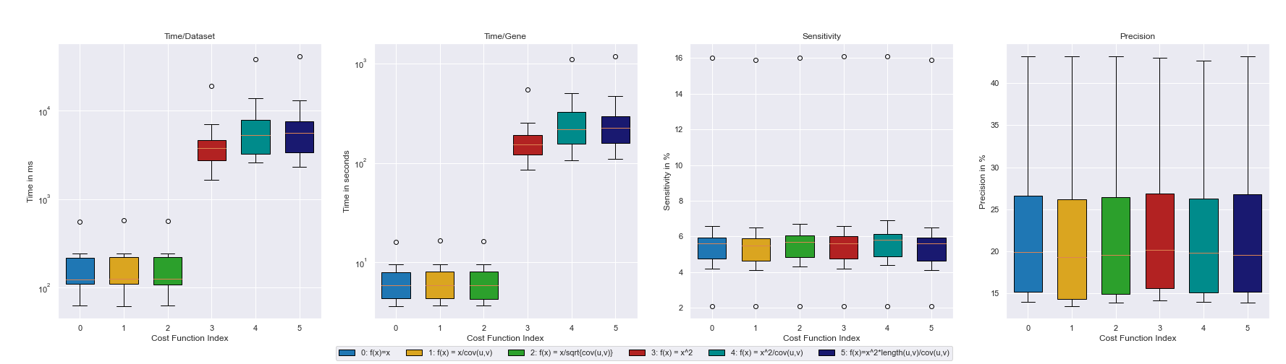
Analysis for flow-based Optimization (TLLP)

Slide 35
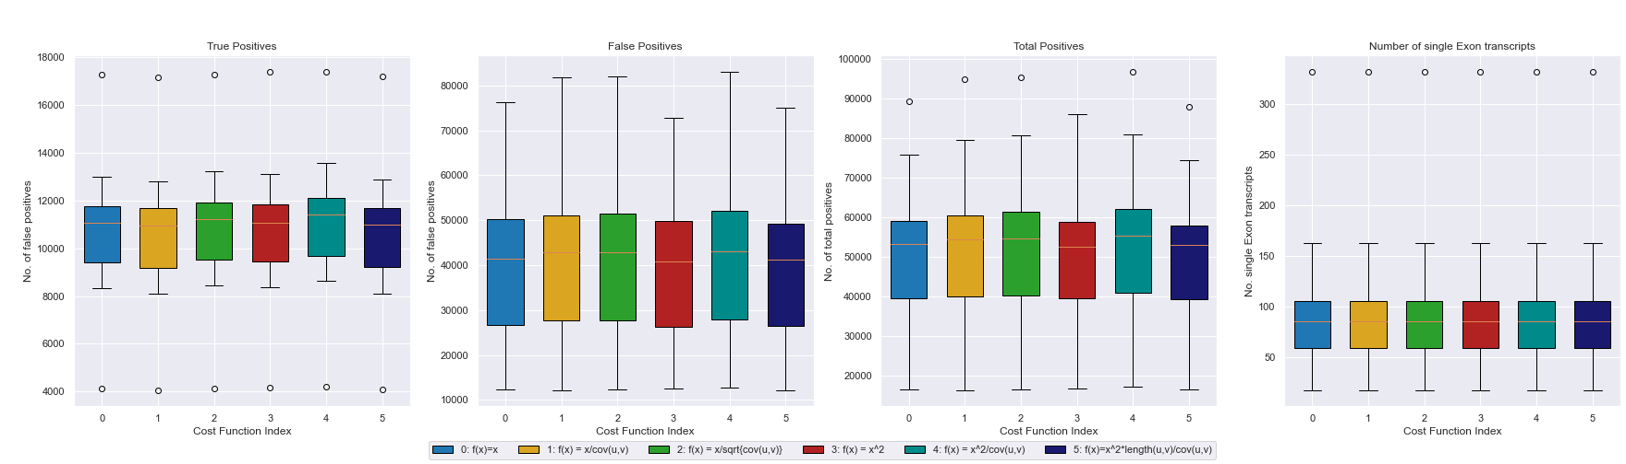
Analysis for flow-based Optimization (TLLP)

Slide 36
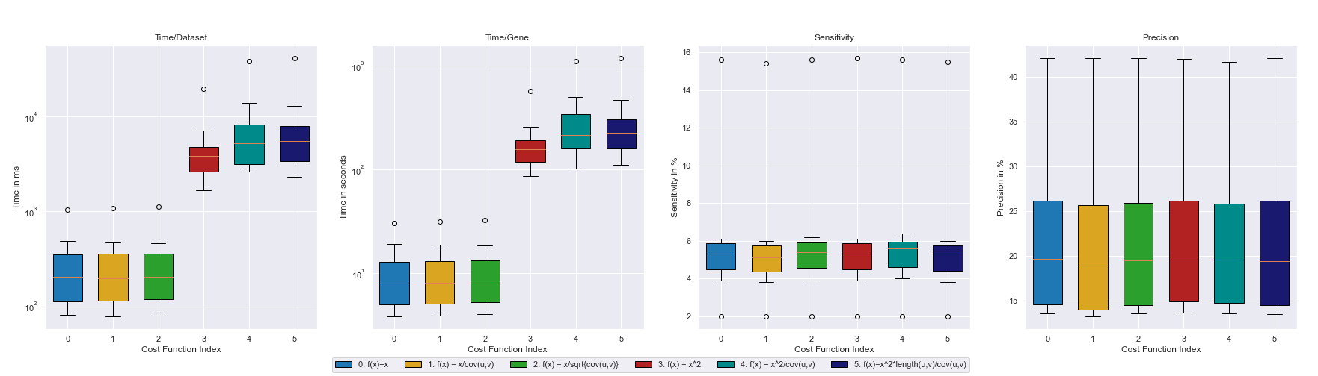
Analysis for flow-based Optimization (TLMF)

Slide 37
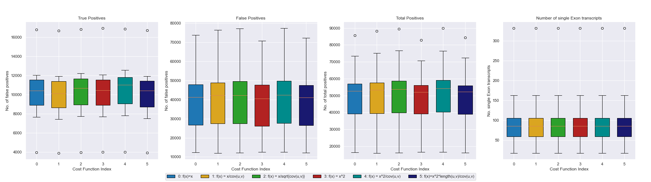
Analysis for flow-based Optimization (TLMF)

Slide 38
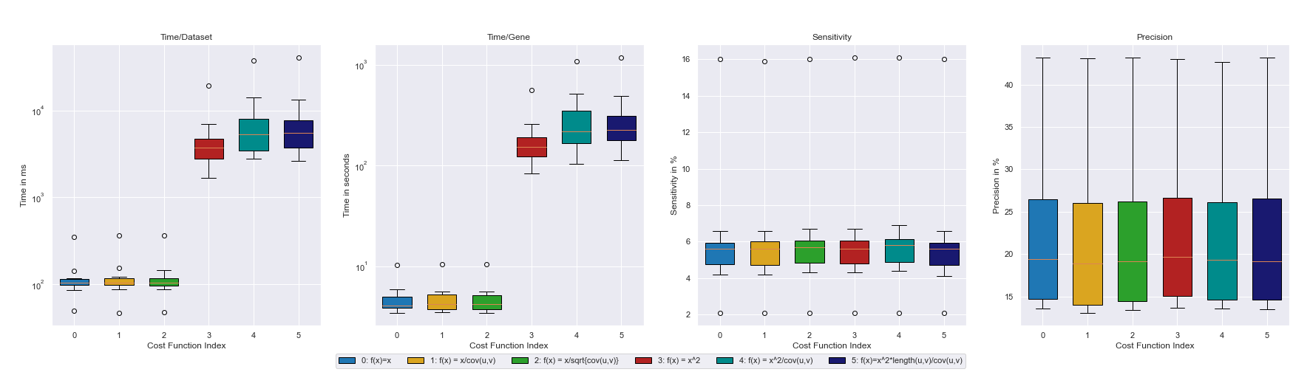
Analysis for flow-based Optimization (DPLP)

Slide 39
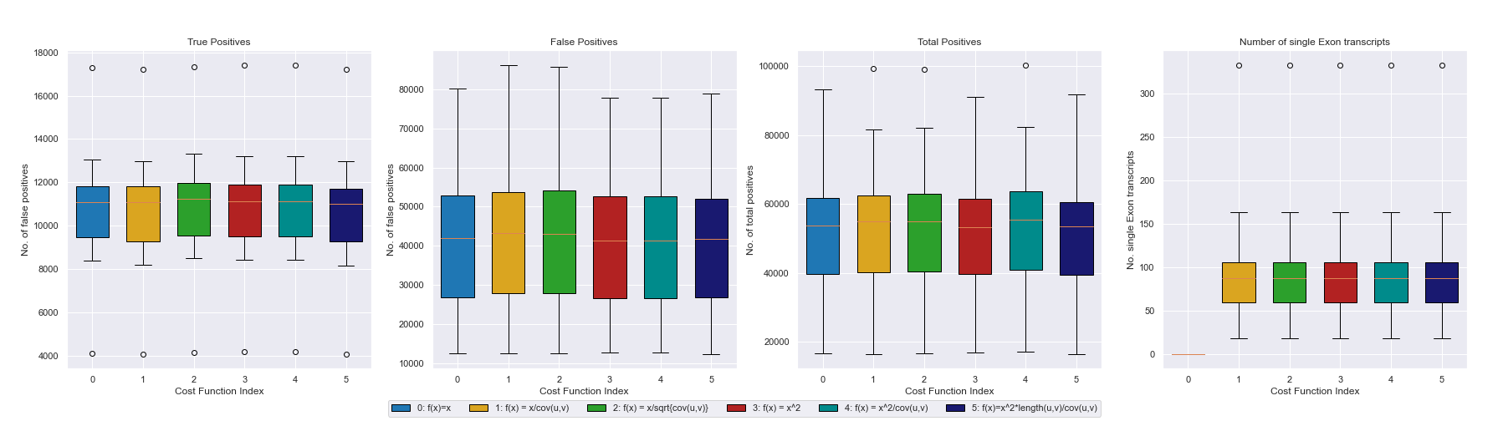
Analysis for flow-based Optimization (DPLP)

Slide 40
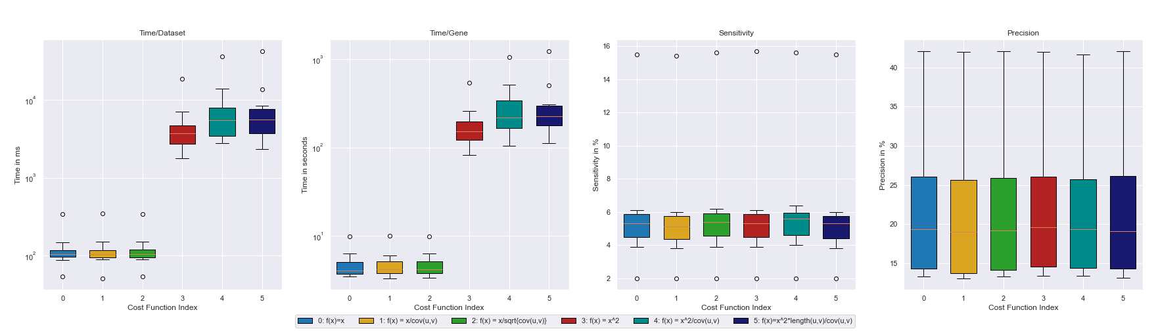
Analysis for flow-based Optimization (DPMF)

Slide 41
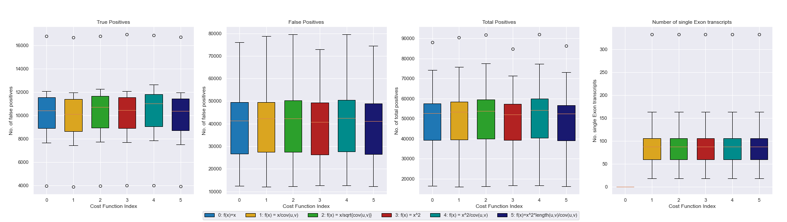
Analysis for flow-based Optimization (DPMF)

